Slide 1

Ten works of contemporary African literature nobody should miss, and why
The Textual Worlds of South-Eastern Africa
University of Southampton, UK
6 March 2024
Lynda Gichanda Spencer, Associate Professor, Rhodes University, South Africa
Grace A Musila, Department of African Literature, University of the Witwatersrand, Johannesburg

Slide 2
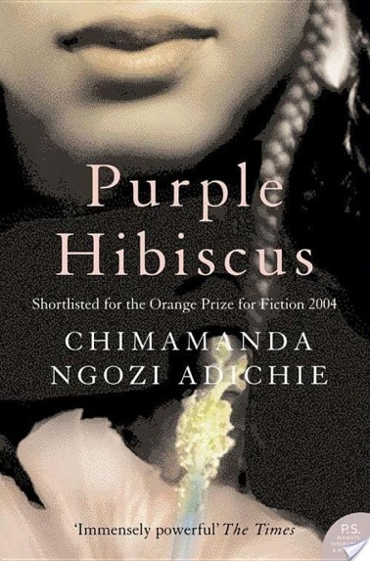

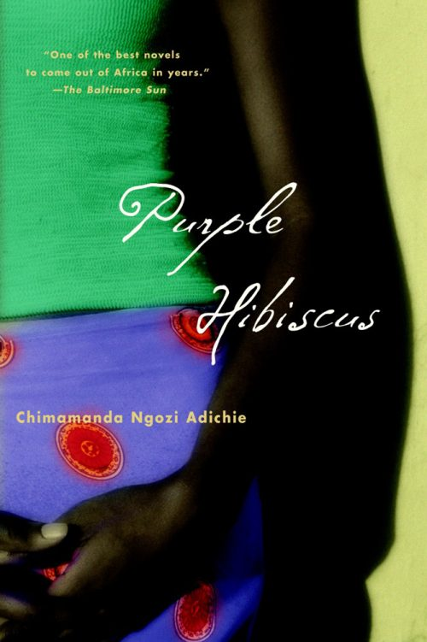

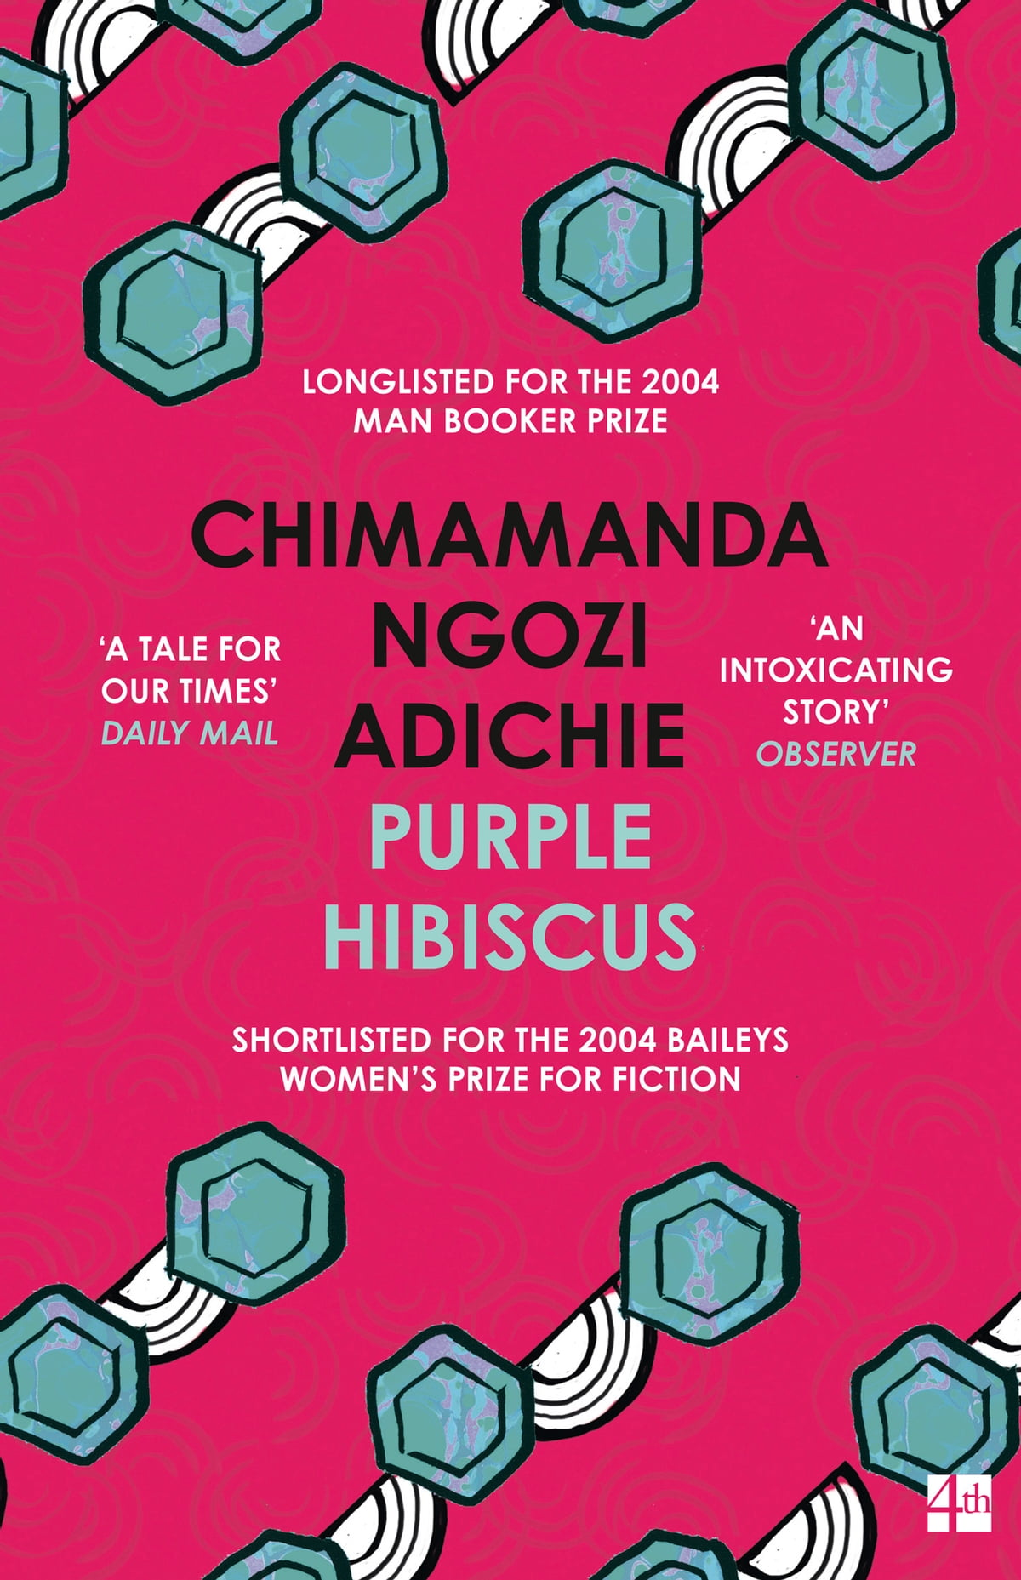
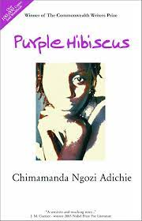
Purple Hibiscus (2003) by Chimamanda Ngozi Adichie [Nigeria]

Slide 3
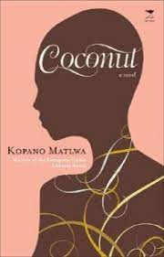
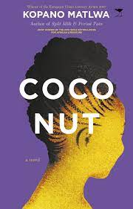
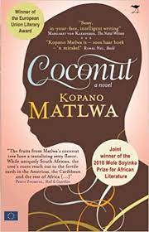
Coconut (2007) by Kopano Matlwa [South Africa]

Slide 4
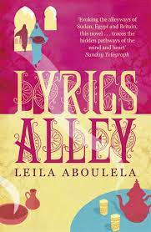
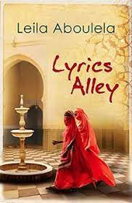

Lyrics Alley (2010) by Leila Aboulela [Sudan]

Slide 5
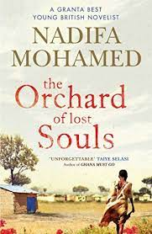
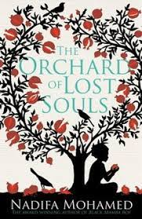
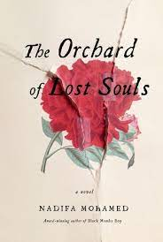
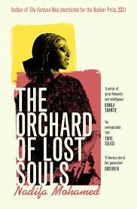
The Orchard of Lost Souls (2013) by Nadifa Mohamed [Somalia]

Slide 6
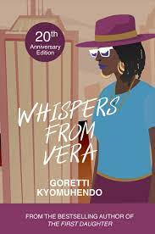

Whispers from Vera (2003/23) by Goretti Kyomuhendo [Uganda]

Slide 7

The Shadow King (2019) by Maaza Mengiste. [Ethiopia]

Slide 8
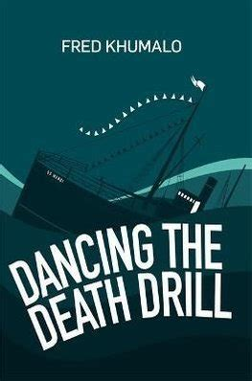
Dancing the Death Drill (2017) by Fred Khumalo [South Africa]

Slide 9

Stay with Me (2017) by Ayobami Adebayo [Nigeria]

Slide 10
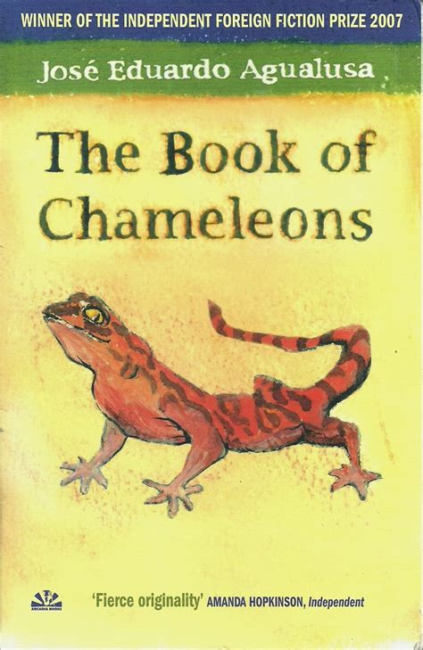
The Book of Chameleons (2008) by Jose Eduardo Agualusa [Angola]

Slide 11

How to Read the Air ( 2010 ) by Dinaw Mengestu [Ethiopia]

